Slide 1
Pipelined 16-Bit Processor
Sonia Leonato Soiras, Daniel Kostecki, and Thi Nguyen

Slide 2
Pipelining
IF (fetch)
Instructions fetched from instruction memory and placed in registers
ID (decode)
Instructions decoded
EX (execute)
Instructions are executed
MEM (memory)
Memory is read or written
WB (write back)
Results of program are written back into registers

Slide 3
D_latch D_flip_flop
What it is: Data latch used to build a D flip flop
Required module: none
Used in: D_flip_flop
Function: Used as a basic “storage unit”, holding one bit of data
What it is: Data flip flop
Required module: D_latch
Used in: register
Function: Store the D input

Slide 4
register reg_file
What it is: a 16-bit register
Required module: D_flip_flop
Used in: reg_file
Function: storage, added together along with multiplexers to make a register file
What it is: a register file
Required module: register, mux4x1_16bit, decoder
Used in: CPU
Function: register file using 3 registers

Slide 5
mux4x1 mux4x1_16bit
What it is: a 4x1 multiplexer
Required module: none
Used in: mux4x1_16bit, ALU1, ALUmsb
Function: multiplexer used for picking one of 4 inputs
What it is: a 16 bit 4x1 multiplexer
Required module: mux4x1
Used in: reg_file
Function: a 16 bit variety of the multiplexer built out of mux4x1

Slide 6
mux2x1
What it is: A 2x1 multiplexer.
Used in: ALU, mux2x1_2bit, mux2x1_16bit
Function: Selects one of the two inputs and forwards that single register into an output.

Slide 7
halfadder and fulladder
What they are: Adders.
Used in: ALU.
Function: The full adder module performs the addition of 3 bits and stores the sum and the carry out. It uses the half adder that realizes the same operation with just 2 bits.

Slide 8
ALU
What it is: 16-bit ALU (Arithmetic Logic Unit)
Function: Takes an operation (op) input as well as an 'a' and 'b' input. Performs the operation with the registers and the result is sent to the write data (wd) of the register file along with the zero bit.
Stage: Execute.
Required modules: ALU1 and ALUmsb

Slide 9
ALU1
ALUmsb
What it is: 1-bit ALU.
Used in: ALU.
Function: Used to handle bits 0-14 (least significant bits) using a 2x1 and 4x1 multiplexer as well as a full adder.
What it is: 1-bit ALU.
Used in: ALU.
Function: Used to handle bit 15 (the most significant bit) using a 2x1 and 4x1 multiplexer as well as a full adder.

Slide 10
mux2x1_2bit & mux2x1_16bit
What it is: A 2-bit 2x1 multiplexer.
Required module: Two mux2x1
Used in: CPU
Stage: Execute
Function: Multiplexer for RegDst (register destination) in CPU module.
What it is: 16-bit 2x1 multiplexer.
Required modules: 16 mux2x1
Used in: CPU
Stage: Instruction Fetch, Execute
Functions:
IF stage: Branch multiplexer
EXE stage: ALUSrc multiplexer

Slide 11
MainControl
What it is:
A module that takes in instruction as an input.
Used to co-ordinate CPU’s operations.
Used in: CPU
Stage: Instruction Fetch
Control format: RegDst, AluSrc, MemtoReg, RegWrite, MemWrite, Branch, AluCtrl

Slide 12
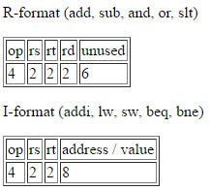
CPU
What it is: It is a processor that carries out the instruction of the program.
Test program:

Slide 13
Stages in CPU
Instruction Fetch: Fetches the current program location and loads the instruction.
Instruction Decode: Allows CPU to determine what instruction is to be performed.
Execution: Execute the operation.
Memory Access: Access an operand in data memory.
Write Back: Write the result into a register.

Slide 14
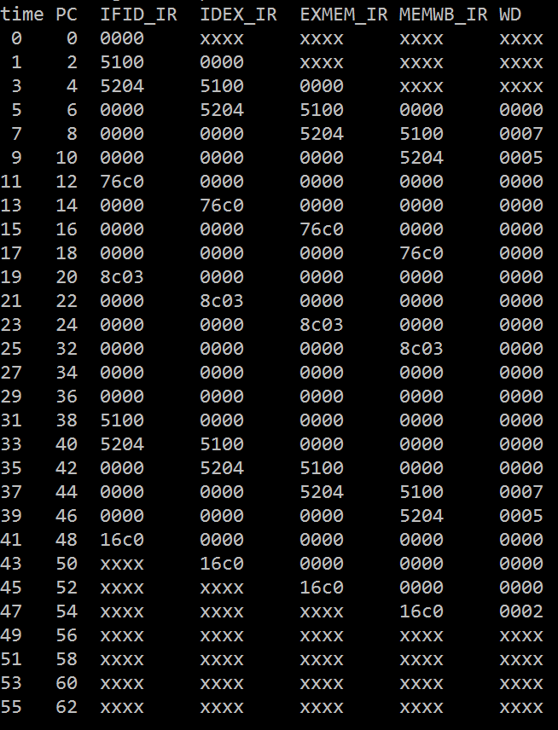
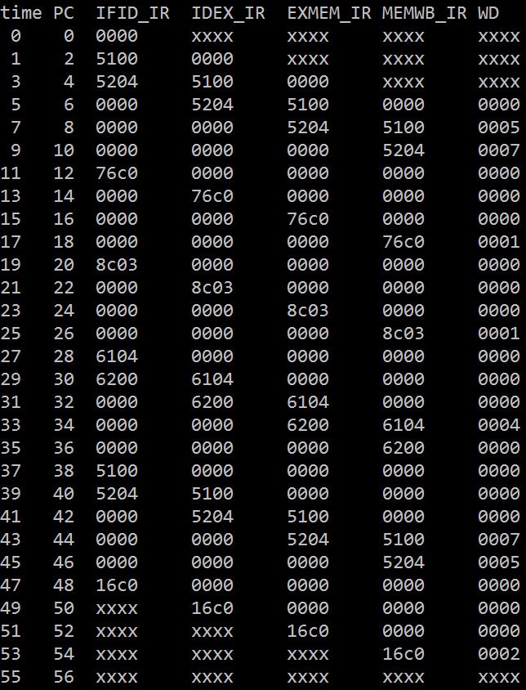
Results
Branch Taken Branch Not Taken
Load data 1 in $1
Load data 2 in $2
$d = 1 if $s < $t, else = 0
If $3 == 0, skip sw
Store $1 into data 2.
Store $2 into data 1.
Load data 1 and 2.
Subtract $1 - $2

